Slide 1
CougarMingle
Where Cougars Unite

Slide 2
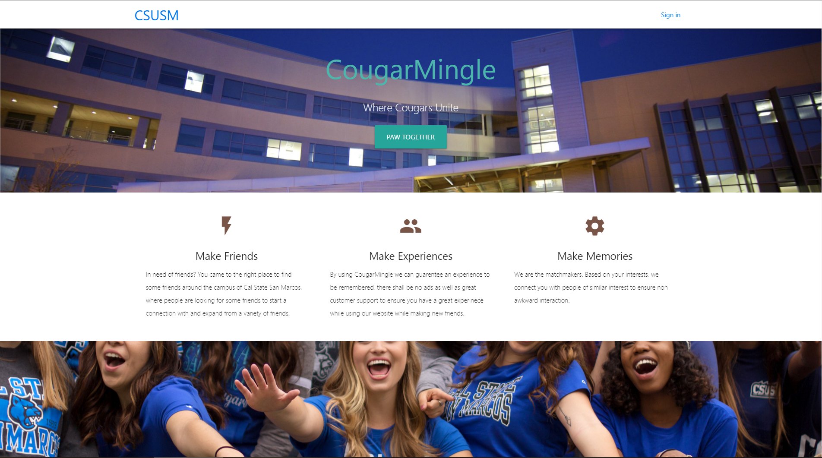
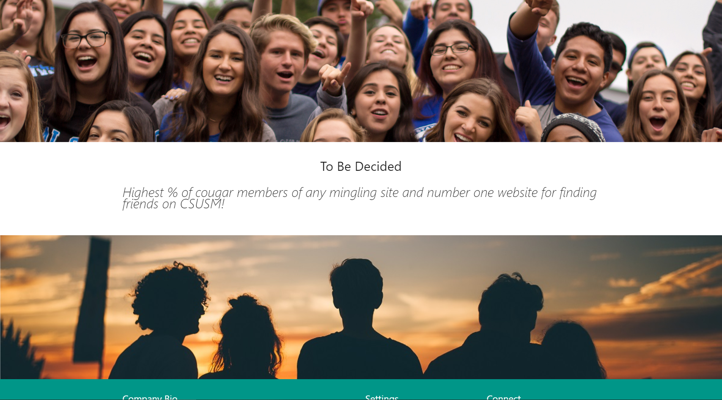
Michael
Able to make the homepage just the design is a little bit off.
Changed the whole homepage and was able to make progress.
Was able to finish editing the whole homepage
Editing User Page

Slide 3
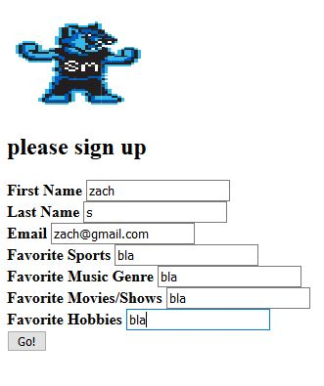
Zach
Monday morning: Started personality questionnaire
Monday afternoon: added categories/pictures to questionnaire
Tuesday morning: Connected survey to the sign in page
Tuesday afternoon: Made survey questions submit to database(with help of Jack)

Slide 4
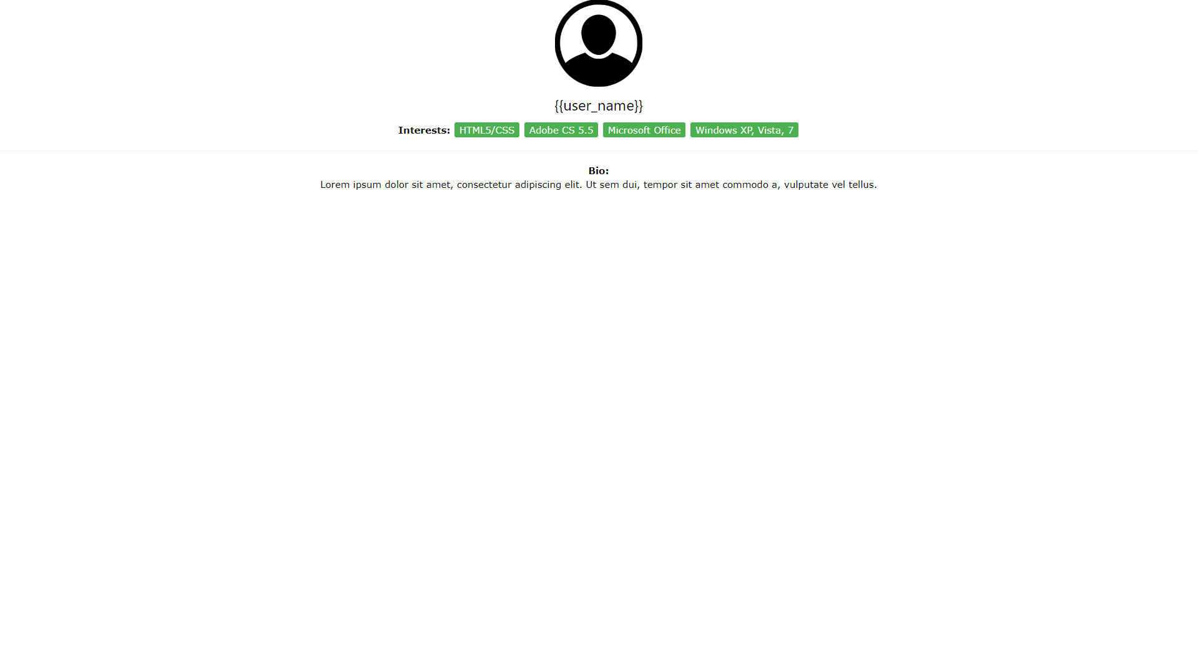
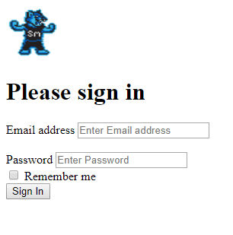
Gaby
Googles users API
Did sign up and sign in page
Did a user page
Linked home page to sign up
page

Slide 5
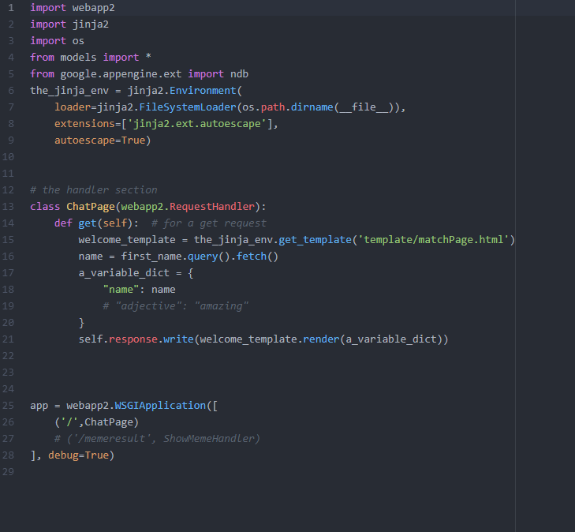
Jack
Formatted the site.
Started the chat site and played around with cloud database.
Some difficulties

